Slide 1
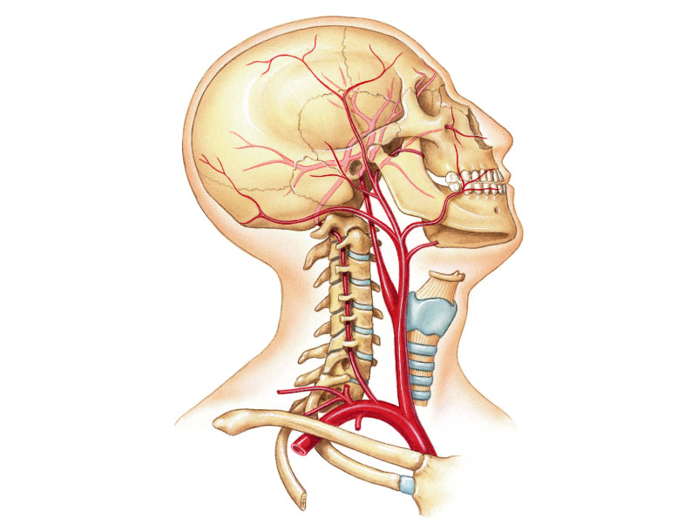
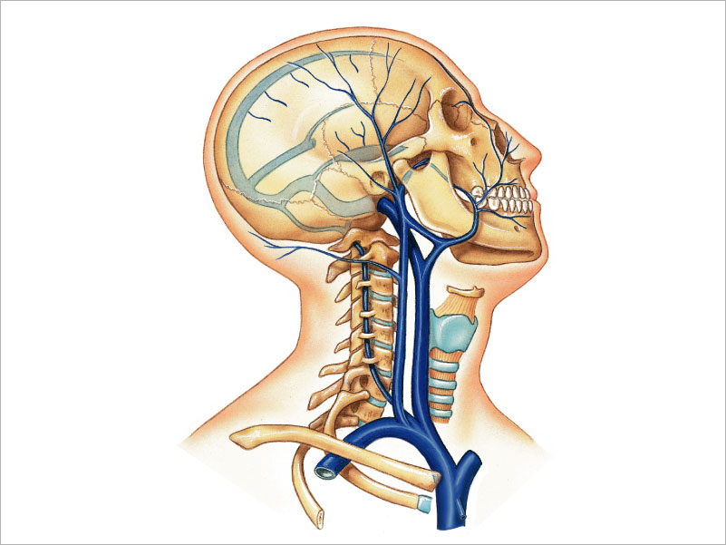
PTAOTA 106 Unit 1 Lecture 3

Slide 2
The Basics
Arteries: Carry blood away from the heart toward tissues. They typically have thicker vessels walls to handle increased pressure. Contain internal and external elastic lamina that allow stretch and recoil (the reason you can feel a pulse clinically).
On models, arteries are colored red if they carry oxygenated blood and blue if they carry deoxygenated blood.
Veins: Carry blood back to the heart from tissues. They have thinner vessels walls designed to collapse and one way valves. They lack elastic lamina. Compression of veins by muscle contraction helps move blood.
On models, veins are blue if the carry deoxygenated blood and red if they carry oxygenated blood.

Slide 3
Elements of the Cardiovascular System found in the head and neck region are the arteries and veins that supply the region
Major Arteries
Superior Temporal
Maxillary
Facial
Occipital
Internal Carotid
External Carotid
Common carotid
Vertebral
Subclavian
Brachiocephalic Trunk
Major Veins
Superior sagittal Sinus
Transverse Sinus
Sigmoid Sinus
Temporal
Occipital
Facial
Maxillary
External Jugular
Internal Jugular
Vertebral
Brachiocephalics

Slide 4
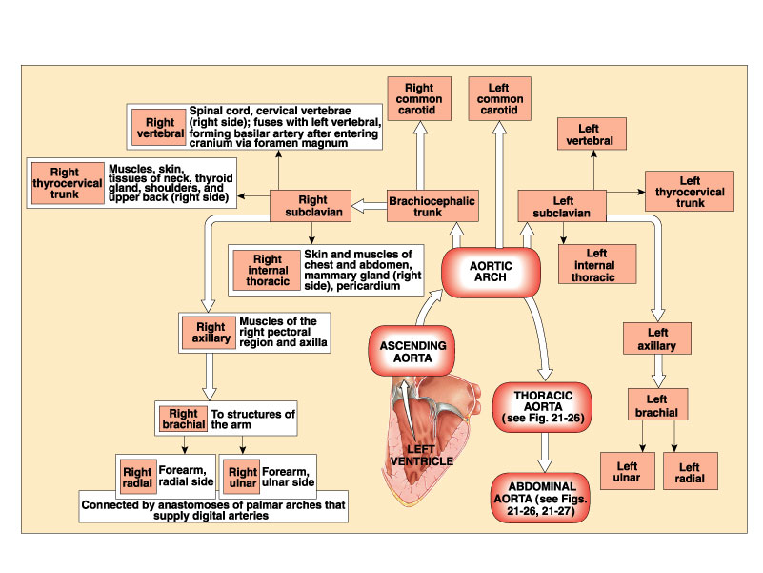
Overview of Arterial Blood flow patterns

Slide 5
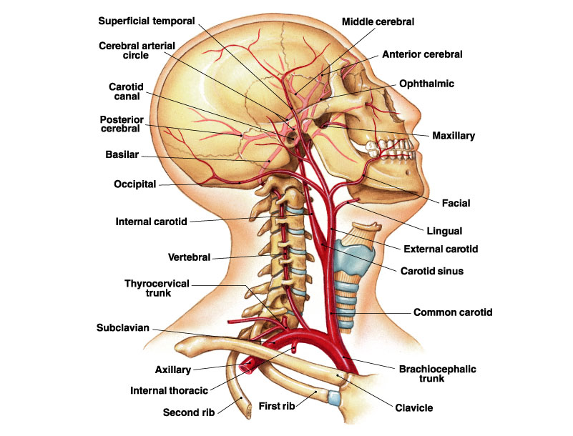
Major Arteries of the Head and Neck

Slide 6
Distribution of Major Arteries of the Head and Neck
External Carotid | Branches that supply external head area
Maxillary | Upper/Lower jaw, chewing muscles, teeth, nasal cavity, and Dura Mater
Facial | Muscles of the anterior portion of the face
Superficial Temporal | Parotid Salivary glands and most of the superior aspects of the scalp
Occipital | Posterior aspects of the scalp
Internal Carotid | Brain and internal aspects of the skull
Vertebral | Spinal cord in cervical region and Brain
Common Carotid | Supplies the External and Internal Carotids
Subclavian | Gives raise to Vertebral and supplies arms

Slide 7
Distribution of Major Arteries of the Head and Neck
Anterior cerebral | (IC) supply most of the cerebral hemisphere except the occipital lobes
Middle cerebral | (IC) Supply most of the lateral surface of the cerebral hemispheres
Basilar | Formed by union of the L&R vertebral, Cranial meninges and cerebrum
Posterior cerebral | Terminal branch of the basilar, supply interior aspect of cerebral hemispheres and occipital lobe
Circle of Willis | An anastomosis for the two vertebral and internal carotid arteries. Gives rise to numerous small branches that supply the brain. Important source of collateral circulation in the event of gradual obstructions.

Slide 8
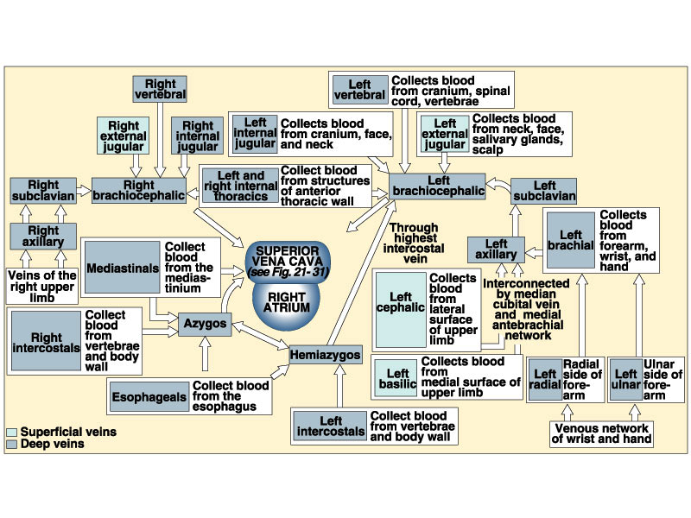
Basic Blood patterns for Veins

Slide 9
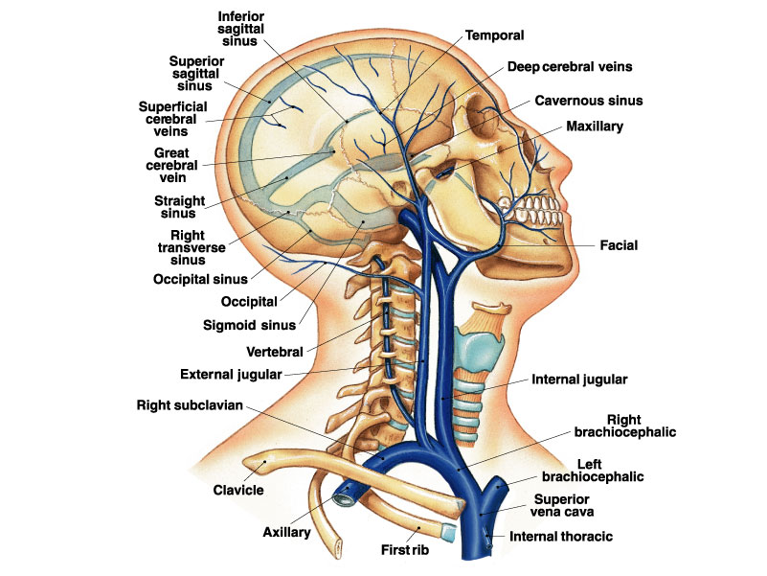
Major Veins of the Head and neck Region

Slide 10
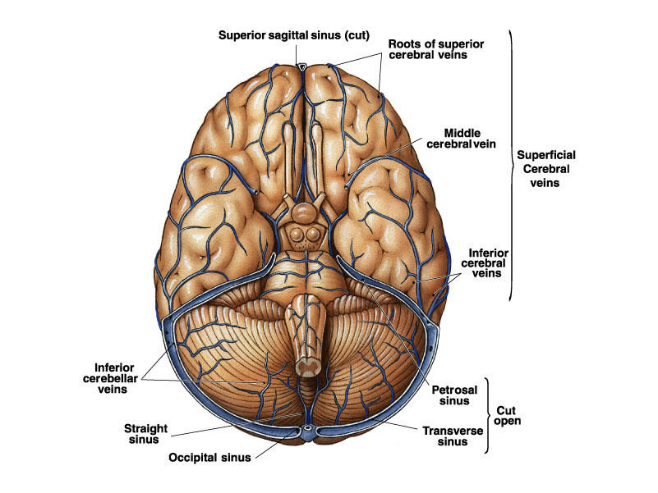
Venous Blood flow from the Brain

Slide 11
Areas drained by the Major Veins of the Head and Neck
Superior Sagittal Sinus | Drains all CSF and passes blood on to Transverse Sinuses posterior
Transverse Sinus | Passes blood along to Sigmoid Sinuses
Sigmoid Sinus | Passes blood along to the Internal Jugular
Temporal Vein | Drains Parotid Salivary glands and most of the superior aspects of the scalp. Passes blood along to External Jugular.
Occipital | Drains posterior aspects of the scalp. Passes blood along to External Jugular.
Facial | Drains Muscles of the anterior portion of the face. Passes blood to the Internal Jugular
Maxillary | Drains Upper/Lower jaw, chewing muscles, teeth, nasal cavity, and Dura Mater. Passes blood to the External Jugular

Slide 12
Areas drained by the Major Veins of the Head and Neck
External Jugular | Passes blood to the Brachiocephalic.
Internal Jugular | Passes blood to the Brachiocephalic
Brachiocephalic | Both Brachiocephalic veins come together to form the Super Vena Cava.

Slide 13
Clinical Concerns
Occlusions: Obstruction of blood flow, result from thrombi, thrombophlebitis, or tumors.
Cerebral contusions: brain trauma in which the pia is striped for the brain surface allowing blood to enter the subarachnoid space .
Cerebral Lacerations: Damage that results in ruptured blood vessels allowing bleeding into the brain and subarachnoid space, causing intracranial pressure and cerebral compression.
Ischemic Stroke: Impaired cerebral blood flow with development of neurological deficits. Most common causes are spontaneous cerebrovascular accidents such as embolism, thrombosis, hemorrhage, subarachnoid hemorrhage.

Slide 14
Clinical Concerns
Hemorrhagic Stroke: Follows the rupture of an artery usually caused by an aneurysm.
Transient Ischemic Attack (TIA): Neurological symptoms resulting from temporary ischemia. The symptoms of staggering, dizziness, light-headedness, fainting, and parasthesias last a few minutes, but can persist for up to an hour.

